Slide 1
Model data with Power BI Desktop
aka.ms/PL300-3

Slide 2
Agenda
Introduction to data modeling
Data types
Star schema
Manage relationships
Create relationships
Edit relationships
Create hierarchies

Slide 3
Introduction to data modeling

Slide 4
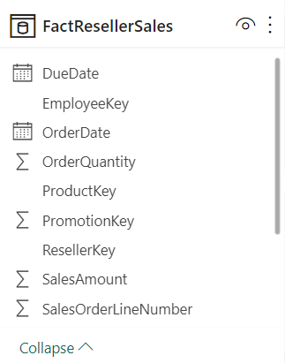
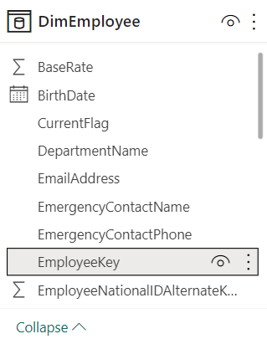
Data table types
Fact tables are activities or events.
Dimension tables provide the details.
Notes:
On this slide, we see the fact table in the middle. DimProduct and DimEmployee are both dimension tables.
In data modeling, understanding the components of a data model is crucial, including fact and dimension tables and the relationships between them. Fact tables contain activities or events, while dimension tables describe the entities or details related to those activities.
Fact: Represents activities, observations, or events such as sales orders, stock balances, temperatures, etc.
Dimension: Describes business entities like products, people, places, and concepts, providing details or answers to questions like "who, what, when, where, why, how."
Creating a well-designed data model in Microsoft Power BI offers numerous benefits. It enhances data understanding, simplifies report building, enables faster data exploration, facilitates simpler aggregations, ensures more accurate reports, and reduces future maintenance efforts.
Defining specific rules for an ideal data model is challenging due to the uniqueness and usage of data. Generally, a smaller data model is preferred for improved performance and ease of use. However, determining the exact criteria for a smaller data model is subjective and depends on heuristics and individual context.

Slide 5
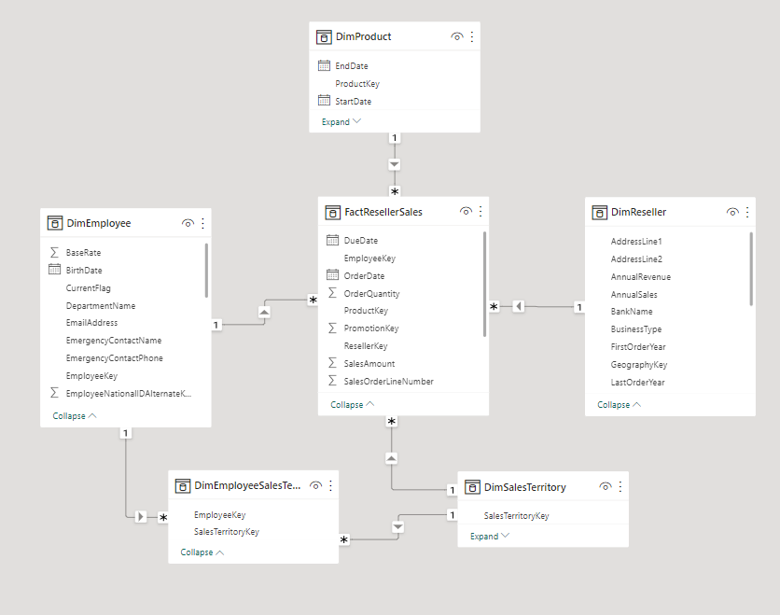
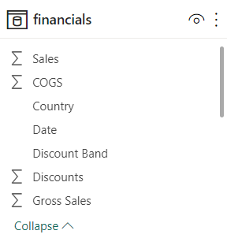
Understand star schemas
Notes:
Power BI combines tables from different sources into a single dataset, making it easier to analyze and report on data. The star schema is a common data modeling technique used in Power BI.
In the star schema, we have a fact table connected to several dimension tables. This separation simplifies the data and provides a clear hierarchy and context for analysis. By connecting the fact table to these dimension tables, we establish relationships and determine the level of detail in the data.
The star schema is a popular and effective method in Power BI. It allows us to create relationships between tables, analyze data efficiently, and create informative reports.

Slide 6
Manage relationships

Slide 7
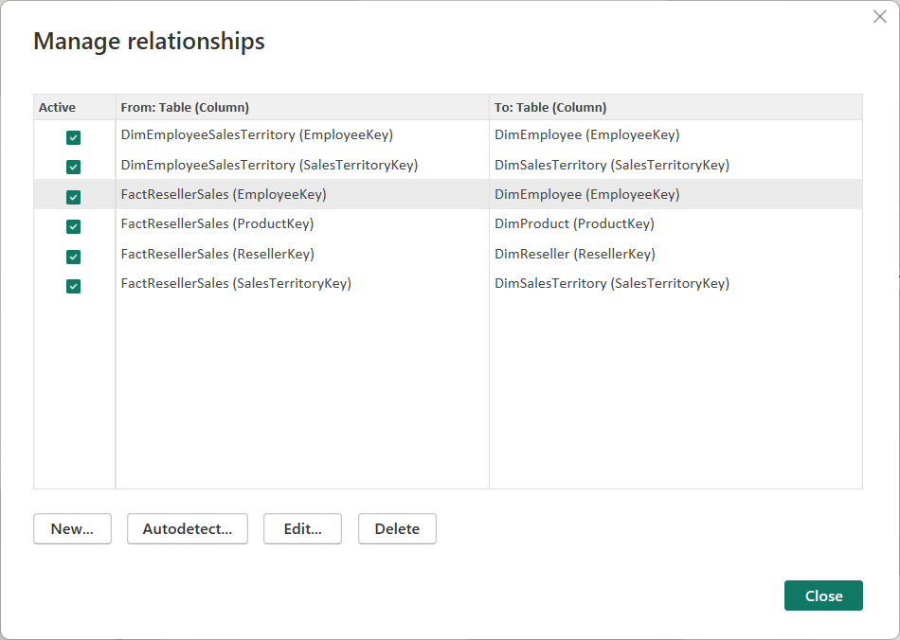
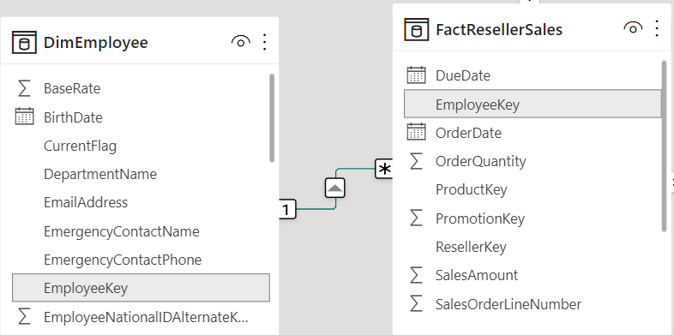
Create relationships
Notes:
Power BI provides the capability to establish relationships between tables from various data sources, such as enabling you to bring together data from Microsoft Excel and relational databases into a cohesive dataset. Let's explore how to create these relationships effectively:
Existing relationships: When connecting to a relational database, it's worth noting that relationships may already be defined by the database architect using primary and foreign keys.
(Note: This knowledge is not essential for this course but can clarify the readiness of data for relationship creation.)
Auto-detect relationships: automatically detect relationships between tables based on the data. You can leverage this feature and make necessary modifications or delete relationships as needed to align with your data model and analysis requirements.
Creating relationships with multiple columns: Relationships can be established using multiple columns within a table. By holding the CTRL key and selecting the desired columns, you can create relationships based on specific criteria.
(Note: This functionality differs from merging queries in Power Query and adds value to your data modeling process.)
Active and inactive relationships: Each table can have only one active relationship, but it is possible to define multiple relationships between tables.
For example, you can create one active relationship with the date table for a sales fact table and define additional relationships as inactive. These inactive relationships can be utilized later for implementing DAX calculations or exploring different analysis perspectives.
Lead-in for next slide: draw attention to the visual representation of relationships, specifically the arrow direction and the 1:* notation displayed on each table.

Slide 8
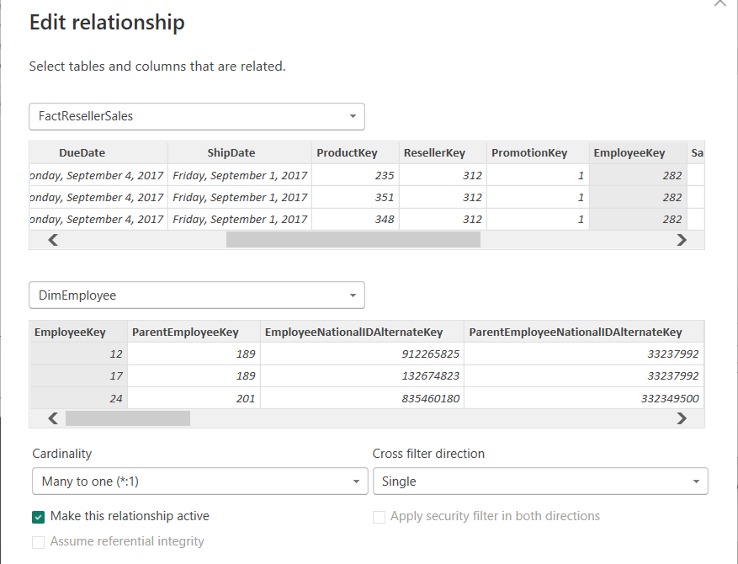
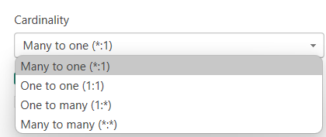
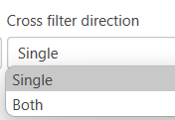
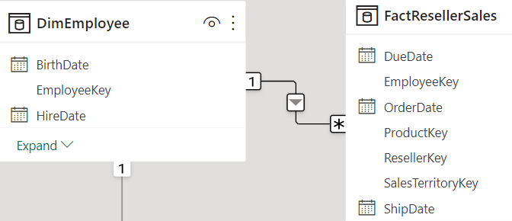
Edit relationships
Notes:
<BUILD SLIDE>
Unlike other database management systems, Power BI has the concept of directionality to a relationship. This directionality plays an important role in filtering data between multiple tables.
<CLICK>
Cardinality in Power BI Desktop relationship refers to the uniqueness of data values in a column. It determines the relationship between tables based on the number of records that correlate between them. In the context of many-to-one (*:1) cardinality, it means that there are multiple records in the left (top) table that correspond to a single record in the right (bottom) table.
Many-to-one (*:1) or one-to-many (1: *) cardinality:
Describes a relationship in which you have many instances of a value in one column that are related to only one unique corresponding instance in another column.
Describes the directionality between fact and dimension tables.
Is the most common type of directionality and is the Power BI default when you are automatically creating relationships.
<CLICK>
Cross filter direction determines the flow of data filtering between tables in a relationship.
On the other hand, if the cross filter direction is set to "Both" between these tables, filtering can occur in both directions. This means that selecting a specific product in the Products table will filter the Sales table to show only the sales data related to that product. Similarly, selecting a specific sales record in the Sales table will filter the Products table to display only the relevant product information.
Using bidirectional filtering can create complex interactions and may result in unexpected or undesired filtering outcomes.
For example, if a user selects a specific product in the Products table, it can filter the Sales table to show relevant sales data. However, this bidirectional filtering can also impact the Products table, potentially leading to a distorted view of product information.
Additionally, enabling both cross filter directions can introduce performance issues, as the bidirectional filtering requires more computational resources to process and maintain the synchronized filters between tables.
If you create a many-to-many relationship, you’ll get a warning asking if it’s intentional, as they are very difficult to manage. We won’t go into more detail.

Slide 9
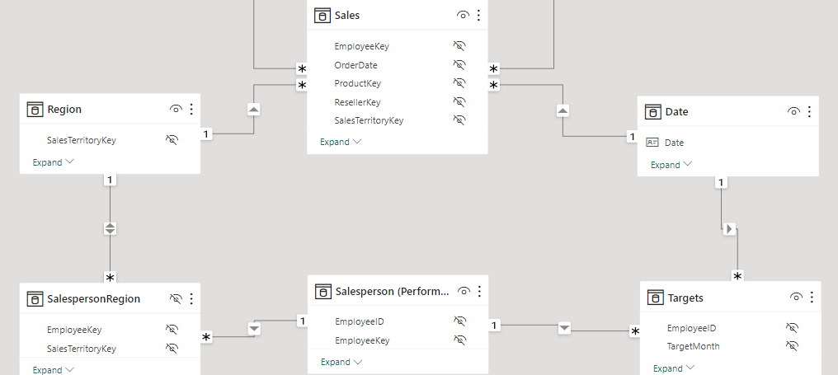
Implications of circular relationships
Notes:
Modeling data is about establishing and maintaining relationships so that you can effectively visualize the data in the form that your business requires. When you are creating these relationships, a common pitfall that you might encounter are circular relationships.
For example, you are developing reports for the Sales team and are examining the relationships between tables. In a poorly designed data model, Table 1 has a many-to-one relationship with a column in Table 2, but Table 2 has a one-to-many relationship with Table 3 that has its own relationship with Table 1. This web of relationships is difficult to manage and becomes a daunting task to build visuals because it is no longer clear what relationships exist. Therefore, it is important that you are able to identify circular relationships so that your data is usable.
Relationship dependencies
To understand circular relationships, you first need to understand dependencies.
For example, consider that you have the following calculated column Total in the Sales table.
Sales[‘TotalCost] = Sales[‘Quantity’] * Sales[‘Price’]
TotalCost depends on Quantity and Price, so if a change occurs in either quantity or price, a change will occur in TotalCost as well. This example outlines a dependency of a column on other columns, but you can also have dependencies between measures, tables, and relationships.
Consider the following relationships between dSalesPerson, fSales, and dCustomer. A change in dCustomer will result in a change in fSales, which results in changes in dSalesPerson. These types of dependencies can exist within relationships.

Slide 10
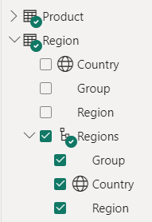
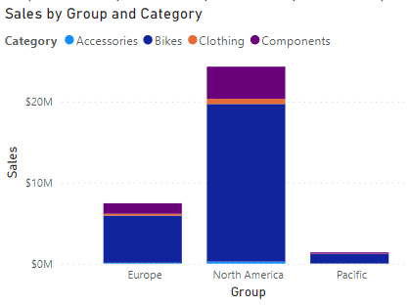

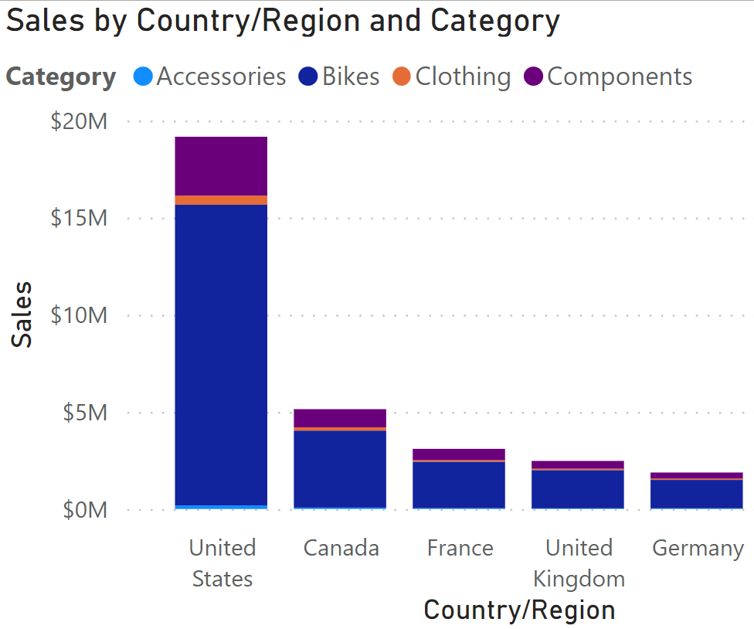
How to use hierarchies for data fields
Notes:
Hierarchies in Power BI allow you to organize and explore data in dimension tables by creating structured relationships between different levels of detail. They enable you to drill down into specific data points and gain insights at various levels of granularity.
To create a hierarchy, access the Data pane in Power BI and select the columns representing the levels of the hierarchy. Once the hierarchy is created, it can be used in visualizations.
Example scenario: Let's consider a scenario where you want to analyze sales data by group, region, and country/region. By creating a hierarchy in the Location dimension table, you can easily navigate through the different levels of geography. This hierarchy will provide you with the flexibility to view data at a high level, such as total sales by region, and then drill down to country/region and city levels to gain more detailed insights.
By leveraging hierarchies, you can easily navigate through different levels of data and gain insights at various levels of granularity. This enhances your ability to explore and analyze data effectively in Power BI.

Slide 11
DEMO
Design a data model in Power BI

Slide 12

Lab: Design a data model in Power BI Desktop
In this lab, you’ll commence developing the data model. It will involve creating relationships between tables, and then configuring table and column properties to improve the friendliness and usability of the data model.
Create model relationships
Configure table and column properties
Create hierarchies and quick measures

Slide 13
Knowledge check: data models
What is the difference between a fact table and a dimension table?
Fact tables contain observational data while dimension tables contain information about specific entities within the data.
Fact tables contain information about specific entities while dimension tables contain information about observational data.
There is no difference.
How do you describe a star schema?
Fact and dimension tables with no relationships between them.
Multiple fact tables with relationships to one dimension table.
Multiple dimension tables with relationships to one fact table.

Slide 14
Recap
In this section, we covered:
Fact and dimension tables.
Designing a star schema layout.
How relationships connect tables.
Managing relationships.
Creating hierarchies.

Slide 15
Create calculations with DAX in Power BI
aka.ms/PL300-4

Slide 16
Agenda
Introduction to DAX
What is DAX
Calculated measures, columns, and tables
Advanced DAX concepts
Filter context
Semi-additive measures
Time intelligence functions
Optimize DAX performance
Variables in DAX expressions
Performance analyzer

Slide 17
Introduction to DAX

Slide 18
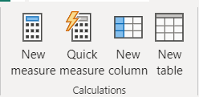
What is DAX?
Data Analysis Expressions
Library of functions and operators
Build formulas and expressions
Create calculated measures, columns, and tables
Notes:
Data Analysis Expressions (DAX) is a programming language that is used throughout Microsoft Power BI for creating calculated columns, measures, and custom tables. It is a collection of functions, operators, and constants that can be used in a formula, or expression, to calculate and return one or more values. You can use DAX to solve numerous calculations and data analysis problems, which can help you create new information from data that is already in your model.
In Power BI, you can use different calculation techniques and functions to create measures or calculated columns. Primarily, you will be able to achieve the same result by using these techniques; however, the key is to know how and when to apply them. By having a basic understanding of when and how to use which technique, you will be able to create robust and high-performance data models.

Slide 19
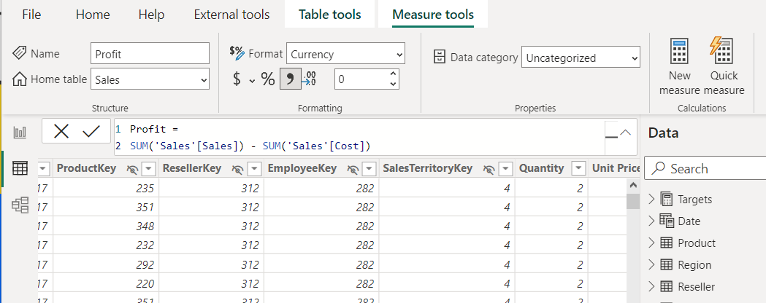
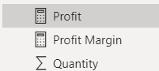
Create calculated measures
Defined with DAX definitions
Computed on the fly.
Not stored in data model.
Responsive to interactions.
Indicated by calculator icon.
Notes:
Measures in Power BI are essential for performing calculations and summarizing data within a DAX model. They enable the aggregation of values across multiple rows, allowing for a comprehensive view of the data.
Measures are commonly used in data analysis and offer a wide range of functions, including sums, averages, minimums, maximums, and counts. What makes measures particularly powerful is that they are not pre-calculated; their values are determined only when used in a report. This dynamic nature ensures that measures update in real-time, responding to user interactions within the report.
This dynamic behavior is one of the key advantages of Power BI reports. By creating measure calculations and combining them with filters and other visuals, users can explore the data and generate insightful visualizations. This flexibility empowers users to uncover meaningful insights and delve deeper into the data based on their specific needs and interests.

Slide 20
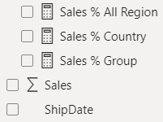
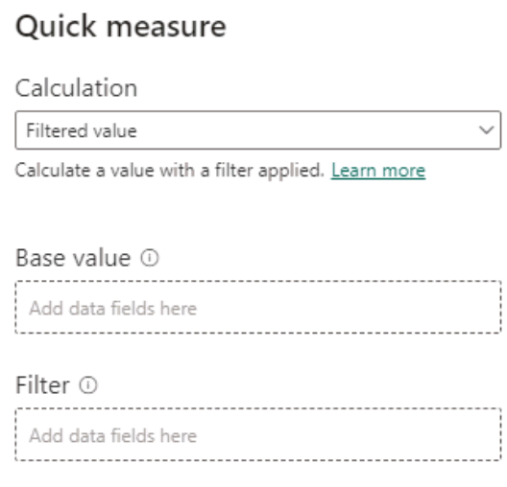
Implicit vs. Explicit vs. Quick measures
Notes:
By default, Power BI automatically aggregates numerical columns using functions like sum, average, min, max, count, or count distinct as the default summarization. This automatic aggregation is called an implicit measure, indicated by the sigma symbol. You can modify or disable implicit measures by adjusting the default summarization settings.
Explicit measures, on the other hand, are intentionally created measures where you define the calculation in the formula bar. With explicit measures, you have full control over the calculation logic and cannot modify the summarization once defined. They are indicated by a calculator.
Quick measures are predefined calculations in Power BI Desktop designed to assist beginners. While there are a limited number of available calculations, you can easily select the appropriate fields, and Power BI generates the measure for you, helping you learn the DAX syntax.

Slide 21
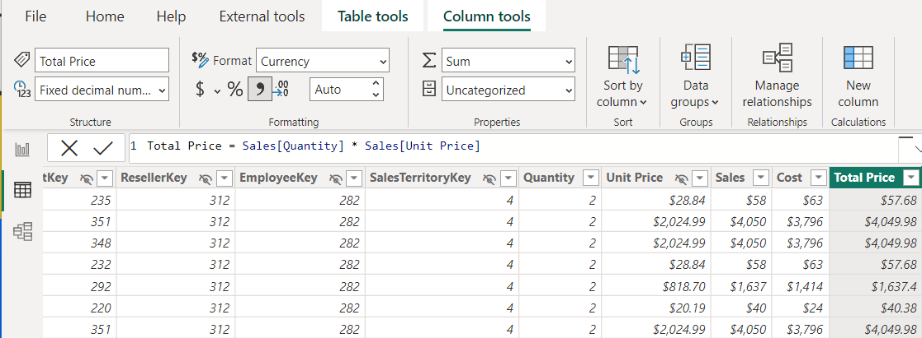
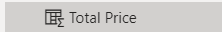
Create calculated columns
Defined using DAX expressions.
Computed & stored in data model.
Useful “helper/connector columns.”
Recalculated during data refresh.
Table and Sigma icon.
Notes:
A calculated column in Power BI is an extension of a table that uses a DAX formula to evaluate values for each row. It allows you to augment the data from different sources by creating a column that didn't originally exist.
For example, let's say you have a sales transaction table with columns like Order ID, Product ID, Quantity, and Unit Price. However, there's no column for the total sales amount per order. Using DAX, you can create a calculated column called Total Price by multiplying the Quantity and Unit Price values for each row.
To create a calculated column, select the ellipsis (...) button on the table in the Data pane and choose New column. Replace the default "Column =" text with the desired DAX expression, like:
Total Price = 'Sales OrderDetails'[Quantity] * 'Sales OrderDetails'[Unit Price]
Calculated columns are a type of custom column. You can create custom columns in three ways: in the source query, using Power Query, or by using DAX in Power BI.
Creating a calculated column in Power BI using DAX doesn't require dataset refresh to see the changes, unlike the other methods. However, it's important to limit use of calculated columns due to potential performance impacts and increased data refresh time when dealing with large datasets.

Slide 22
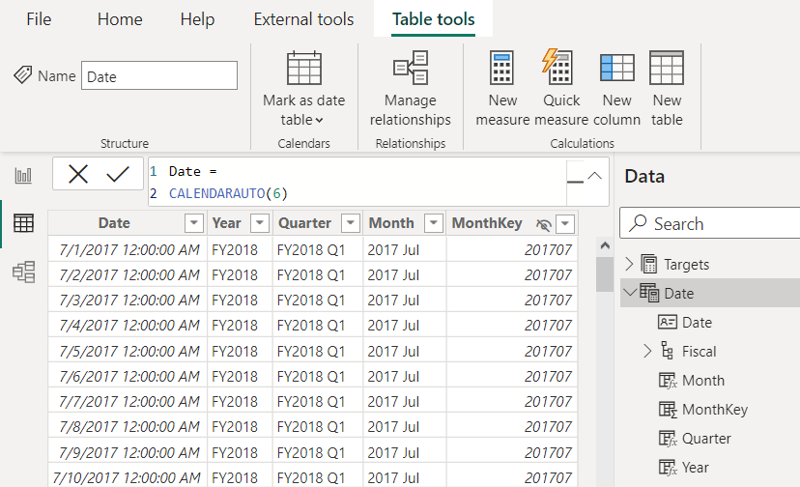
Create calculated tables
Defined using DAX expressions.
Computed & stored in data model.
Useful for aggregating data or creating custom tables.
Table and calculator icon.
Notes:
Calculated tables in Power BI are tables that are created based on DAX expressions or calculations. Unlike regular tables that store data, calculated tables are generated on the fly during query execution based on the defined DAX expressions. Calculated tables can be created manually by writing DAX expressions or by utilizing functions like CALENDARAUTO, as shown on this slide.
Calculated tables can be used to extend or enhance the data model by incorporating additional columns or performing complex calculations. They are useful in scenarios where you need to generate new tables based on existing data or perform calculations that are not easily achieved using regular measures.
By leveraging calculated tables, you can provide more flexibility and analytical capabilities to your reports and dashboards.

Slide 23
Columns vs. measures
Calculated columns:
Measures:
Create values for each row in table.
Store values in the .pbix file.
Increases data model size.
Row-by-row calculation can impact performance.
Must be referenced with measures for reuse.
Calculate on demand.
Calculated based on filters.
Doesn’t affect data model size.
DAX expressions may still be suboptimal.
Can reference other measures directly for reuse.
Notes:
The fundamental difference between a calculated column and a measure is that a calculated column creates a value for each row in a table. For this reason, the calculated column can only operate over columns that exist in the same table. For example, if the table has 1,000 rows, it will have 1,000 values in the calculated column.
Calculated column values are stored in the Power BI .pbix file. Each calculated column will increase the space that is used in that file and potentially increase the refresh time.
Measures are calculated on demand. Power BI calculates the correct value when the user requests it. When you previously dragged the Total Sales measure onto the report, Power BI calculated the correct total and displayed the visual. Measures do not add to the overall disk space of the Power BI .pbix file.
Measures are calculated based on the filters that are used by the report user. These filters combine to create the filter context.
Ideally, you will create measures as needed. If you need a persisted column, consider creating a column in Power Query before choosing a calculated column for model optimization. That’s not to say that calculated columns are invaluable but use them sparingly.

Slide 24
DEMO
Create measures using DAX in Power BI

Slide 25
Lab: Create DAX calculations in Power BI Desktop
Create DAX calculations
In this lab you’ll create calculated tables, calculated columns, and simple measures using Data Analysis Expressions (DAX).
In this lab you learn how to:
Create calculated tables
Create calculated columns
Create measures

Slide 26
Knowledge check: DAX calculations
Which statement about measures is correct?
Measures store values in the data model.
Measures can reference columns directly.
Measures can reference other measures directly.
Which of the following statements describing similarity of measures and calculated columns in an Import model is true?
They can achieve summarization of model data.
They store values in the data model.
They're evaluated during data refresh.

Slide 27
Advanced DAX concepts

Slide 28
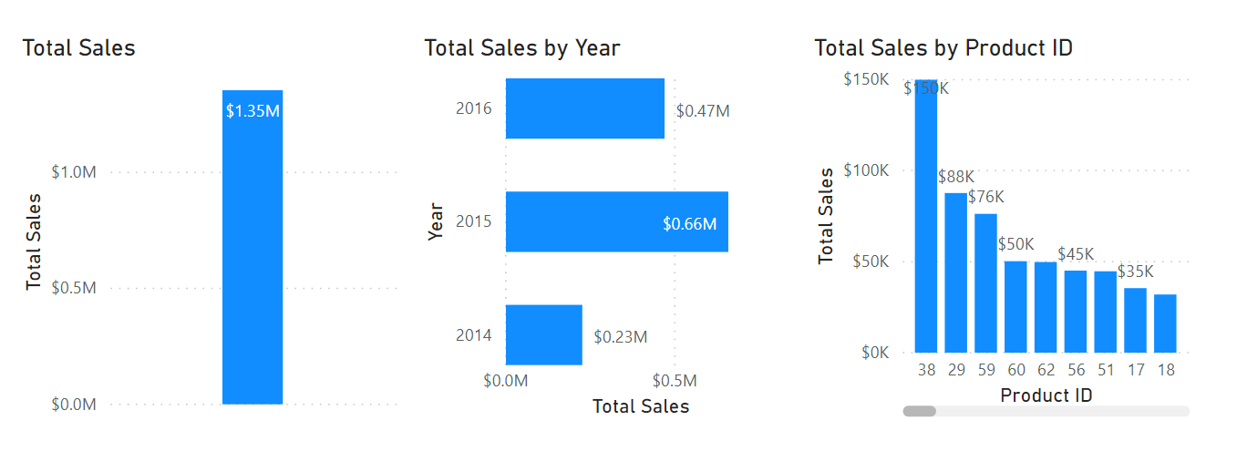
Understanding filter context
Measures are contextually different, or “dynamic,” depending on filters.
Notes:
Filter context in DAX refers to the set of filters applied to data, influencing how calculations and measures are computed and displayed.
For example, these three visuals use the exact same DAX measure: Total Sales. Each visual uses the same DAX measure.
The first visual shows the Total Sales measure without filters.
The second visual is filtered by year.
The third visual, Total Sales is filtered by Product ID.
With Power BI, even though the measure was only defined once, it can be used in these visuals in different ways. Each of the totals is accurate and performs quickly. It is the context of how the DAX measure is used that calculates these totals accurately.

Slide 29
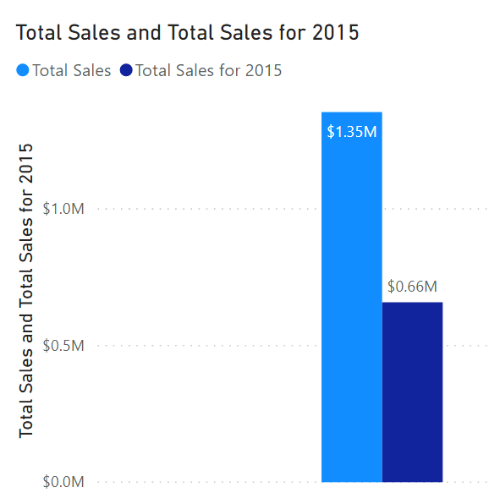
CALCULATE() function
Adjusts how measures interpret data filters, enabling context control.
Total Sales for 2015 =
CALCULATE (
SUM ( 'Sales OrderDetails'[Total Price] ),
YEAR ( 'Sales OrderDetails’[OrderDate] ) = 2015
)
Notes:
The CALCULATE function in DAX is one of the most important functions that a data analyst can learn. The function name does not adequately describe what it is intended to do.
The CALCULATE function is your method of creating a DAX measure that will override certain portions of the context that are being used to express the correct result.
For instance, if you want to create a measure that always calculates the total sales for 2015, regardless of which year is selected in any other visual in Power BI, you would create a measure that is similar to the syntax in the following sample:
Total Sales for 2015 = CALCULATE(SUM('Sales OrderDetails'[Total Price]), YEAR('Sales OrderDetails’[OrderDate]) = 2015)
Notice how the measure is named Total Sales for 2015. When you use the CALCULATE function to override the context, it is helpful to name the measure in a way that describes exactly how you are overriding it. In this example, CALCULATE is aggregating the Total Price column, just as you did in the previous measure. However, instead of operating over the entire dataset while using whatever the filter context tells it to do, you are overriding the filter context for the year 2015. No matter what year is selected, you will always get the total for 2015; all other filters still apply. The subsequent example shows this concept in action.
When both measures are added to the previous visual they will resemble the following screenshot.
As shown in image, Total Sales is still USD1.35 million, while the 2015 Total Sales is USD0.66 million.

Slide 30
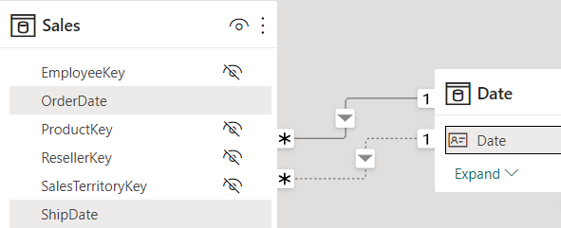
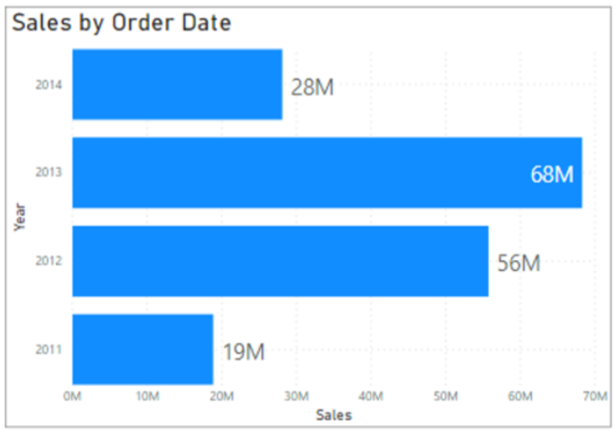
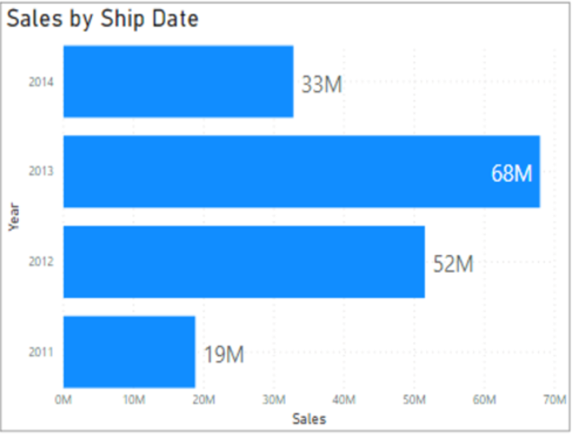
Use inactive relationships with DAX
Enable additional table filtering without impacting the active relationship.
Sales by Ship Date =
CALCULATE (
Sales[TotalPrice],
USERELATIONSHIP (
'Calendar'[Date], Sales[ShipDate])
)
Notes:
<BUILD slide>
Earlier when we discussed role-playing dimensions, we explained that you can create multiple relationships between tables, but only one could be active. In order to leverage the inactive relationships, you need to use DAX. This is the final step in creating role-playing dimensions.
In this image, we see the Sales and Date tables, with two relationships. The active relationship is between OrderDate and Date.
<CLICK>
We can see that we can filter by date to calculate sales. However, if we also wanted to visualize the data by ShipDate, then we need to use DAX.
<CLICK>
To enable filtering on ShipDate, you can use the DAX function USERELATIONSHIP(). This function is used to specify a relationship to be used in a specific calculation and is done without overriding any existing relationships. It is a beneficial feature in that it allows developers to make additional calculations on inactive relationships by overriding the default active relationship between two tables in a DAX expression, as shown in the following example:
Sales by Ship Date = CALCULATE(Sales[TotalPrice], USERELATIONSHIP('Calendar'[Date], Sales[ShipDate]))
Now, you will be able to create the bottom visual.

Slide 31
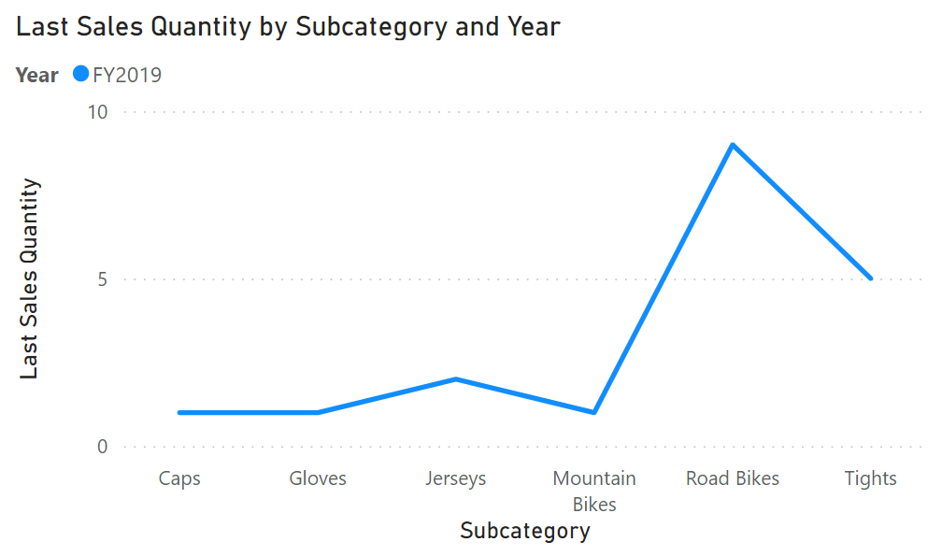
Semi-additive measures
Context-dependent: Results vary based on dimensions.
Time Intelligence: Useful for averages, ratios, balances.
Caution with aggregation: Beware of misleading results when aggregating.
Last Sales Quantity =
CALCULATE(
SUM(Sales[Quantity]),
LASTDATE('Date'[Date])
)
Notes:
Semi-additive measures are a powerful concept in Power BI when standard aggregation methods don't fit the data analysis requirements.
Our slide shows a semi-additive measure called "Last Sales Quantity," which calculates the quantity of sales for the last date within a selected time period. The line chart shows each subcategory’s quantity of sales for the last date in this year.
When would you want to use a semi-additive measure like this? Consider scenarios where you need to analyze inventory or sales data based on specific points in time rather than aggregating across all dates.
For example, if you want to understand the quantity of sales for the last day of each year or the last day of a selected time period, the "Last Sales Quantity" measure becomes invaluable.

Slide 32
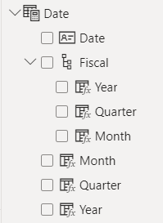
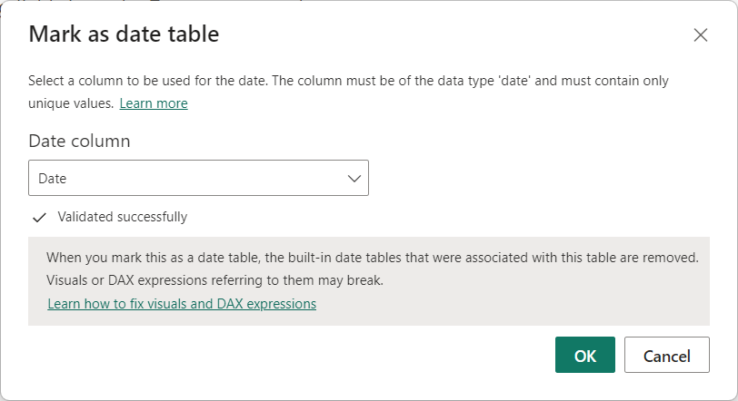
Create a common date table
Notes:
During Power BI report creation, it's often necessary to perform calculations based on date and time. To effectively analyze data over time, creating a date table is crucial. This table provides the necessary formatting for time-oriented values and allows businesses to track performance over months, quarters, fiscal years, and more.
Power BI includes an automatic date/time feature that generates predefined calculated columns for day, month, quarter, and year. However, these columns may not meet specific requirements or can unnecessarily increase model size. Disabling auto date/time doesn't eliminate the need for time intelligence. This is where a common date table comes into play.
Before creating a new common date table, it's advisable to check if there is already an existing one within the organization to avoid duplicating work.
A common date table allows you to standardize date formats and ranges according to company requirements. It can include additional details like company holidays, fiscal vs. calendar dates, and more. By adding month, week, and day number columns, you can filter and aggregate data based on various date types, simplifying complex calculations.
There are several ways to build a common date table:
Source data: Sometimes, source databases or data warehouses already have their own date tables.
DAX functions: You can use DAX functions like CALENDARAUTO() or CALENDAR() to generate a common date table.
Power Query: You can use the M-language in Power Query to define a common date table.
To designate the common date table as the official date table, you can right-click its name in the Fields pane and select "Mark as date table."

Slide 33
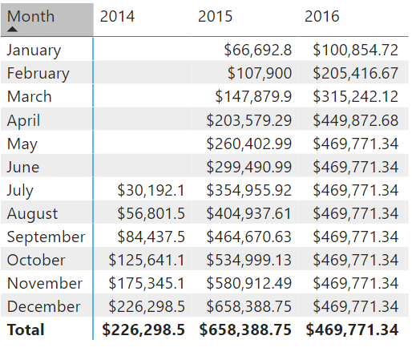
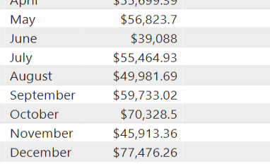
Time Intelligence functions
Total Sales Previous Month =
CALCULATE ( SUM ( Sales[Total Price] ), PREVIOUSMONTH ( 'Date'[Date] ) )
Notes:
All data analysts will have to deal with time. Dates are important, so we highly recommend that you create or import a dates table. This approach will help make date and time calculations much simpler in DAX.
While some time calculations are simple to do in DAX, others are more difficult. For instance, this screenshot shows what happens if you want to display a running total.
Notice that the totals increment for each month but then reset when the year changes. In other programming languages, this result can be fairly complicated, often involving several variables and looping through code.
<CLICK>
DAX makes this process fairly simple, for example, working with time to compare your current sales with the sales of a previous time period. For instance, if you want to see the total sales of the month next to the total sales of the prior month using the DAX CALCULATE() measure:
This measure uses the CALCULATE function, indicating that you're overriding the context to evaluate this expression the way that you want to. You're summing Total Price, as you've been doing throughout this module. For the second argument, you're using PREVIOUSMONTH for the override, which tells Power BI that, no matter what month is the default, the system should override it to be the previous month.
<CLICK>
Now see the new visual using the DAX measure. When you examine the months side-by-side, notice that the total sales for July compared to the total sales for June. Now you can also calculate the difference between current and previous months.

Slide 34
Lab: Advanced DAX calculations in Power BI Desktop
Advanced DAX
In this lab, you’ll create measures with DAX expressions involving filter context manipulation.
In this lab you learn how to:
Use the CALCULATE() function to manipulate filter context
Use Time Intelligence functions

Slide 35
Knowledge check: advanced DAX
What DAX function lets you use inactive relationships?
USERELATIONSHIP
DEACTIVATEFILTERS
OVERRIDECONNECTION
Which type of functions specifically use dates for calculations?
Date and Time
Time Intelligence
Filter
What kind of measure sums for one dimension and uses another aggregation for a different dimension?
Summarized
Aggregated
Semi-additive

Slide 36
Optimize DAX performance

Slide 37
Use variables to improve performance and readability
Without variable:
Sales YoY Growth =
DIVIDE (
( [Sales] - CALCULATE ( [Sales], PARALLELPERIOD ( 'Date'[Date], -12, MONTH ) ) ),
CALCULATE ( [Sales], PARALLELPERIOD ( 'Date'[Date], -12, MONTH ) ) )
With variable:
Sales YoY Growth =
VAR SalesPriorYear = CALCULATE ( [Sales], PARALLELPERIOD ( 'Date'[Date], -12, MONTH ) )
VAR SalesVariance = DIVIDE ( ( [Sales] - SalesPriorYear ), SalesPriorYear )
RETURN
SalesVariance
Notes:
You can use variables in your DAX formulas to help you write less complex and more efficient calculations. Variables are underused when starting with Power BI Desktop, but they are effective, and a great habit to create when you are creating measures.
Some expressions involve the use of many nested functions and the reuse of expression logic. These expressions take a longer time to process and are difficult to read and, therefore, troubleshoot.
If you use variables, you can save query processing time. This change is a step in the right direction toward optimizing the performance of a data model.
The use of variables in your data model provides the following advantages:
Improved performance
Improved readability
Simplified troubleshooting code
Reduced complexity

Slide 38
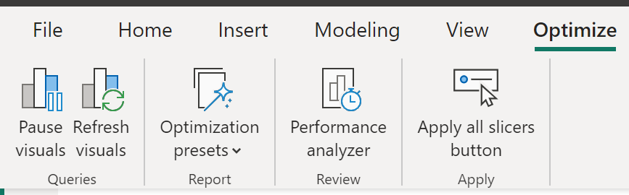
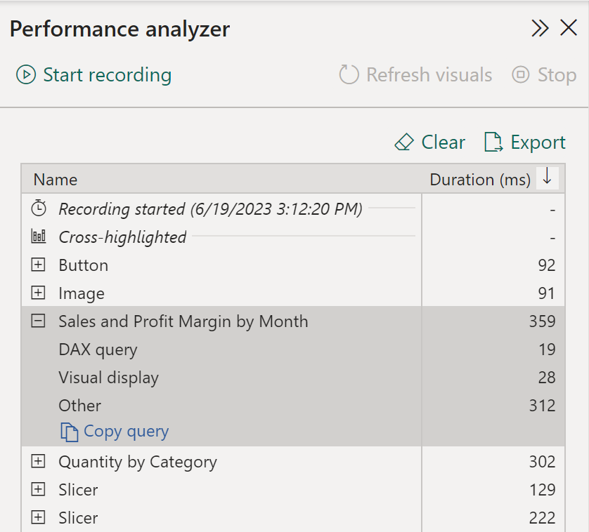
Tune report performance
Performance analyzer in Power BI Desktop
Record report interactions.
Review query and rendering times.
Identify bottlenecks, optimize queries.
Notes:
When you have completed creating your report, the performance of that report depends on how quickly data can load onto the report page. You should test out your report in the Power BI service, to see how it works from an end-user perspective. If you experience any issues yourself, or if the report users have reported issues, you need to investigate the cause of those issues, and take measures to tune the report for more optimized performance.
Analyze Performance:
To investigate the cause of issues, your first port of call is the Performance analyzer tool within Power BI Desktop. Performance analyzer allows you to find out how each of your report elements and provides you with logs which measure (in time duration) how each of your report elements performs when users interact with them. By looking closely at the durations in the logs, you can identify which elements of the report are the most (or least) resource intensive. You can find where the bottlenecks are and this gives you a good starting point for making changes.
Before you run Performance analyzer, ensure you clear the visual cache and data engine cache, otherwise the results will not be accurate. Also, you should set up the report so that it opens on a blank page.
When you have cleared the caches, and opened the report on the blank page, to run the Performance analyzer, go to View tab, select Performance analyzer, and then select Start Recording.
Interact with your report as you would expect a user to, then stop the recording. You will see the results of your interactions displaying in the Performance analyzer pane as you work. When you are finished, select the Stop button. You can then analyze the results in the Performance analyzer pane. You will see the performance results of each item in the report, in milliseconds, under the Duration column.
You can review the results of your performance test in the Performance analyzer pane. To review the tasks in order of duration, longest to shortest, right-click the Sort icon next to the Duration (ms) column header, and then select Total time in Descending order.
The log information for each visual shows how much time it took (duration) to complete the following categories of tasks:
DAX query - The time it took for the visual to send the query, along with the time it took Analysis Services to return the results.
Visual display - The time it took for the visual to render on the screen, including the time required to retrieve web images or geocoding.
Other - The time it took the visual to prepare queries, wait for other visuals to complete, or perform other background processing tasks. If this category displays a long duration, the only real way to reduce this duration is to optimize DAX queries for other visuals, or reduce the number of visuals in the report.
The results of the analysis test help you to understand the behavior of your data model and identify the elements that you need to optimize. You can compare the duration of each element in the report and identify the elements that have a long duration. You should focus on those elements and investigate why it takes them so long to load on the report page.
Metadata
Metadata is information about other data. Power BI metadata contains information on your data model, such as the name, data type and format of each of the columns, the schema of the database, the report design, when the file was last modified, the data refresh rates, and much more.
You can use Power Query Editor in Power BI Desktop to examine the columns, rows, and values of the raw data. You can then use the available tools, such as those highlighted in the following screenshot, to make the necessary changes.
Tune Performance:
The results of your analysis will identify areas for improvement and highlight items that you need to optimize.
A common reason for poor performance is too many visuals on the same page. In the following image you can see an example of a busy page that contains many visuals.
If you identify visuals as the bottleneck leading to poor performance, you can take the following steps to tune the report:
Reduce the number of visuals on the report page; fewer visuals means better performance. If a visual is not necessary and does not add value to the end user, should remove it. Rather than using multiple visuals on the page, consider other ways to provide additional details, such as drillthrough pages and report page tooltips.
Reduce the number of fields in each visual. The upper limit for visuals is 100 fields, so a visual with more than 100 fields will be slow to load (and look cluttered and confusing). Identify fields that are not valuable to the visual and remove them.
If you find that visuals are not causing the performance issues, you should take a close look at the DAX Query results that are displayed in the Performance analyzer pane, and investigate further into those.

Slide 39
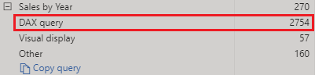
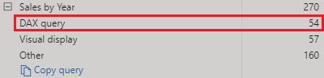
Analyze query plans for optimization opportunities
Count Customers =
CALCULATE (
DISTINCTCOUNT ( Order[ProductID] ),
FILTER ( Order, Order[OrderQty] >= 5 )
)
Count Customers =
CALCULATE (
DISTINCTCOUNT ( Order[ProductID] ),
KEEPFILTERS (Order[OrderQty] >= 5 )
)
Notes:
When you examine the results in the Performance analyzer pane, you can see how long it took the Power BI Desktop engine to evaluate each query (in milliseconds). A good starting point is any DAX query that is taking longer than 120 milliseconds. In this example, you identify one particular query that has a large duration time.
Performance analyzer highlights potential issues but does not tell you what needs to be done to improve them.
In this example, you are trying to count the total number of products with order quantities greater than or equal to five.
<CLICK>
Now the measure replaces the FILTER function with the KEEPFILTER function. When the test was run again in Performance analyzer, the duration was shorter as a result of the KEEPFILTER function.
https://learn.microsoft.com/dax/best-practices/dax-avoid-avoid-filter-as-filter-argument

Slide 40
DEMO
Optimize model performance in Power BI Desktop

Slide 41
Knowledge check: DAX optimization
What benefit do you get from analyzing the metadata?
The benefit of analyzing the metadata is that you can clearly identify data inconsistences with your dataset.
The benefit of analyzing the metadata is to get familiar with your data.
The benefit of analyzing the metadata is to know the number of rows, columns and tables being loaded into your model.
Which of the following statements about relationships in Power BI Desktop is true?
Relationships can only be created between columns that contain the same data type.
Relationships can only be created between tables that contain the same number of rows.
Relationships can be created between tables that contain different types of data.
Notes:
Use the slide animation to reveal the correct answers.

Slide 42
Recap
In this section, we covered:
What DAX is and how to use it.
Creating calculated measures, columns, and tables with DAX.
Benefits of measures vs. calculated columns.
How filter context and CALCULATE() function affect measures.
Inactive relationships and semi-additive measures.
Creating a common date table and Time Intelligence functions.
Using variables and Performance analyzer for performance. .

Slide 43
Thanks
Resources
Design a data model in Power BI
Write DAX formulas for Power BI Desktop models
Add measures to Power BI Desktop models
Use DAX time intelligence functions in Power BI Desktop models

